Slide 1
MAS291
Assignment 01

Slide 2
Theory
What are the probability distributions of
A) Sample Mean
B) Sample Proportion
C) Sample Variance
D) Difference of 2 sample means
E) Difference of 2 sample proportions

Slide 3
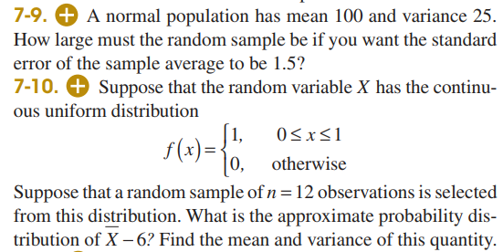
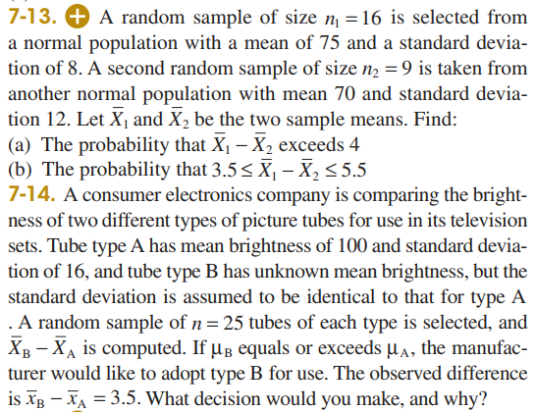
Exercises

Slide 4
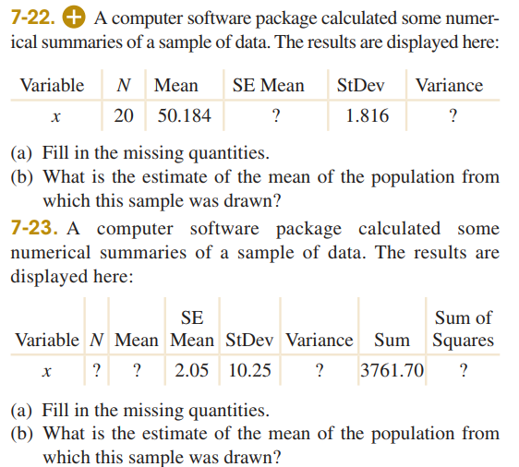
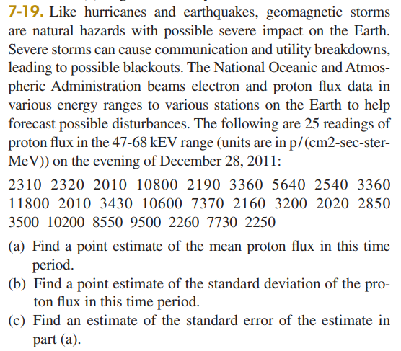
Exercises

